Slide 1



9th June 2023
Time-scale correction of radio-nuclide data
Andrea Marchetti
Luca Menti
Giovanni Merlin
Alberto Saretto

Slide 2

TABLE OF CONTENTS
Introduction
Methods
Results and Discussion
Conclusions

Slide 3
INTRODUCTION

Slide 4

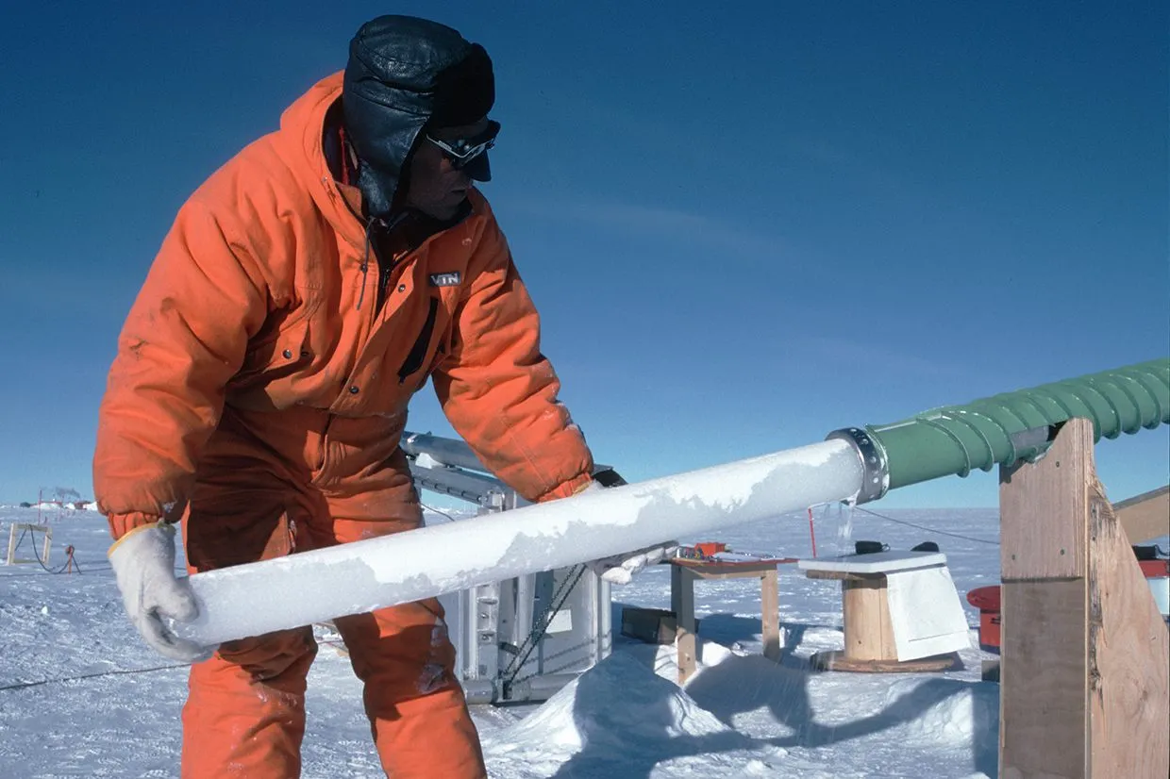
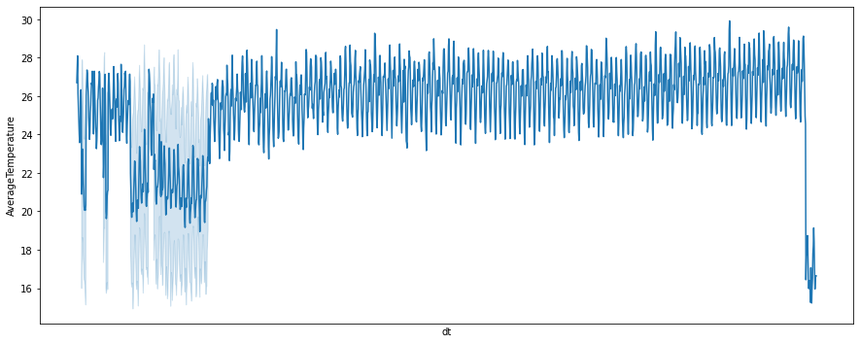

INTRODUCTION: Problem Definition
HISTORIC DATA: CLIMATE, SOLAR ACTIVITY, ...

Slide 5
INTRODUCTION: Problem Definition
HISTORIC DATA: CLIMATE, SOLAR ACTIVITY, ...
Problem: corrupted data timing uncertainty

Slide 6
INTRODUCTION: Problem Definition
HISTORIC DATA: CLIMATE, SOLAR ACTIVITY, ...
Problem: corrupted data timing uncertainty
Aim: correct timescale using reference cycles

Slide 7
INTRODUCTION: Problem Definition
HISTORIC DATA: CLIMATE, SOLAR ACTIVITY, ...
Problem: corrupted data timing uncertainty
Aim: correct timescale using reference cycles
Tools: Bayesian inference with MC sampling techniques

Slide 8
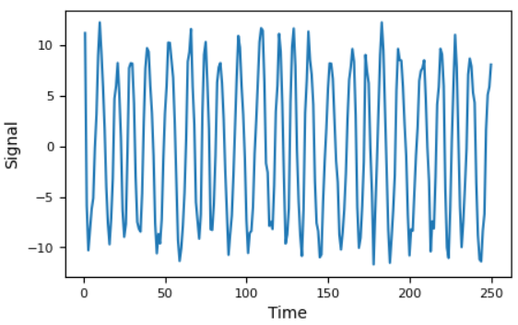
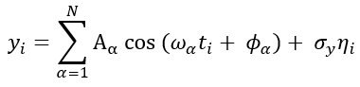
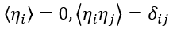
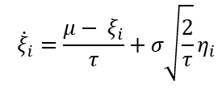
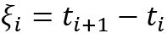
INTRODUCTION: Model Definition
Signal: sum of plane waves
Timesteps: Ornstein-Uhlenbeck
Corruption:
Timestamps
Power Spectrum

Slide 9
INTRODUCTION: Project's Purpose
Task: recover the original signal (timestamps, frequencies, amplitudes, phases)

Slide 10
INTRODUCTION: Project's Purpose
Task: recover the original signal (timestamps, frequencies, amplitudes, phases)
Procedure:
Define the model for the signal and the timestamps

Slide 11
INTRODUCTION: Project's Purpose
Task: recover the original signal (timestamps, frequencies, amplitudes, phases)
Procedure:
Define the model for the signal and the timestamps
Compare the PS to a reference dataset
Signal's periods
8872.5
2185.8
972.53
349.91
Reference periods
7393.40
3681.50
2325.90
963.49
881.63
711.53
514.44
440.98
365.49
349.12

Slide 12
INTRODUCTION: Project's Purpose
Task: recover the original signal (timestamps, frequencies, amplitudes, phases)
Procedure:
Define the model for the signal and the timestamps
Compare the PS to a reference dataset
Signal's periods
8872.5
2185.8
972.53
349.91
Reference periods
7393.40
3681.50
2325.90
963.49
881.63
711.53
514.44
440.98
365.49
349.12
Δ = 0.9%
Δ = 0.2%

Slide 13
INTRODUCTION: Project's Purpose
Task: recover the original signal (timestamps, frequencies, amplitudes, phases)
Procedure:
Define the model for the signal and the timestamps
Compare the PS to a reference dataset
Signal's periods
8872.5
2185.8
972.53 963.49
349.91 349.12
Reference periods
7393.40
3681.50
2325.90
963.49
881.63
711.53
514.44
440.98
365.49
349.12
free
fixed
Δ = 0.9%
Δ = 0.2%

Slide 14
INTRODUCTION: Project's Purpose
Task: recover the original signal (timestamps, frequencies, amplitudes, phases)
Procedure:
Define the model for the signal and the timestamps
Compare the PS to a reference dataset
Bayesian inference on the model's parameters
Signal's periods
8872.5
2185.8
972.53 963.49
349.91 349.12
Reference periods
7393.40
3681.50
2325.90
963.49
881.63
711.53
514.44
440.98
365.49
349.12
free
fixed
Δ = 0.9%
Δ = 0.2%

Slide 15
INTRODUCTION: Bayesian Inference
Parameters:

Slide 16
INTRODUCTION: Bayesian Inference
Parameters:
Bayes' theorem:
posterior likelihood prior

Slide 17
INTRODUCTION: Bayesian Inference
Parameters:
Bayes' theorem:
posterior likelihood prior

Slide 18
INTRODUCTION: Bayesian Inference
Parameters:
Bayes' theorem:
posterior likelihood prior

Slide 19
INTRODUCTION: Bayesian Inference
Parameters:
Bayes' theorem:
posterior likelihood prior

Slide 20
INTRODUCTION: Bayesian Inference
Parameters:
Bayes' theorem:
posterior likelihood prior
properly defined

Slide 21
INTRODUCTION: Bayesian Inference
Parameters:
Bayes' theorem:
posterior likelihood prior
properly defined
Monte Carlo sampling algorithms: Hamiltonian MC, Gibbs sampling

Slide 22
INTRODUCTION: Available Data
Data: Be-10
timeseries in the time range 300 – 9300 YBP
list of the main frequencies in the PS

Slide 23
INTRODUCTION: Available Data
Data: Be-10
timeseries in the time range 300 – 9300 YBP
list of the main frequencies in the PS
Reference: C-14
list of the main frequencies in the PS

Slide 24
INTRODUCTION: Available Data
Data: Be-10
timeseries in the time range 300 – 9300 YBP
list of the main frequencies in the PS
Reference: C-14
list of the main frequencies in the PS
Result evaluation: Be-10 timeseries corrected by means of other methods (volcanic activity)

Slide 25
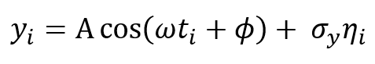
INTRODUCTION: Available Data
Data: Be-10
timeseries in the time range 300 – 9300 YBP
list of the main frequencies in the PS
Reference: C-14
list of the main frequencies in the PS
Result evaluation: Be-10 timeseries corrected by means of other methods (volcanic activity)
Toy model: 3 synthetic, dummy timeseries of a corrupted monochromatic wave

Slide 26
INTRODUCTION: Available Data
Data: Be-10
timeseries in the time range 300 – 9300 YBP
list of the main frequencies in the PS
Reference: C-14
list of the main frequencies in the PS
Result evaluation: Be-10 timeseries corrected by means of other methods (volcanic activity)
Toy model: 3 synthetic, dummy timeseries of a corrupted monochromatic wave
fixed
Ornstein-Uhlenbeck

Slide 27
METHODS

Slide 28
METHODS: MCMC
O(10³) parameters to infer

Slide 29
METHODS: MCMC
High dimensional inference problem
O(10³) parameters to infer
Inefficient numerical integration

Slide 30
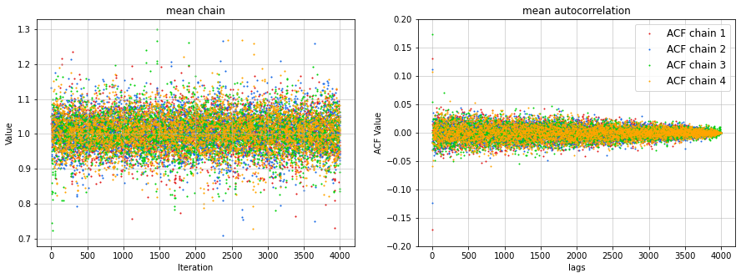
METHODS: MCMC
High dimensional inference problem
O(10³) parameters to infer
Markov Chain Monte Carlo
sampling techniques
Inefficient numerical integration
Produce samples that (approximately) follow the posterior

Slide 31

METHODS: Hamiltonian MC
parameters to infer
Idea: Simulate hamiltonian dynamics with coordinates
auxiliary "momentum"
random variable

Slide 32
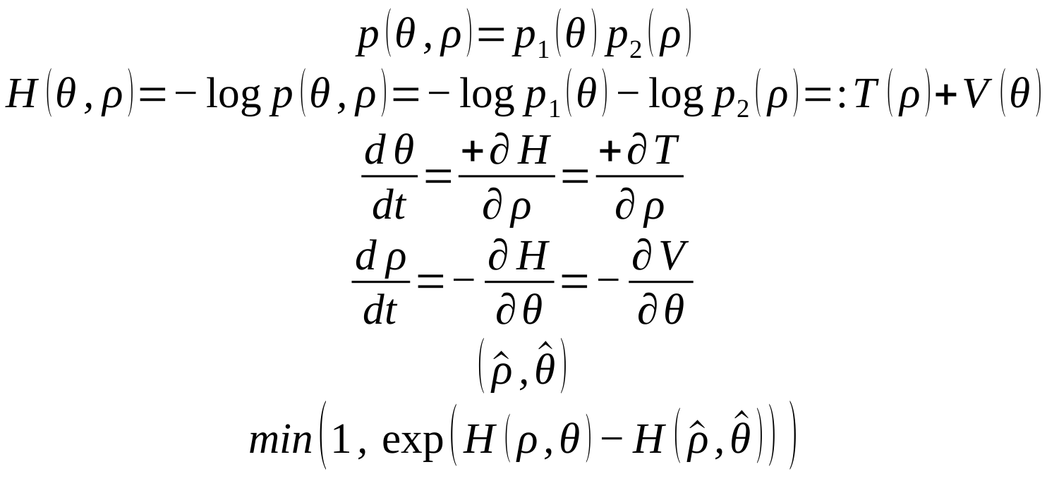
METHODS: Hamiltonian MC
parameters to infer
Idea: Simulate hamiltonian dynamics with coordinates
auxiliary "momentum"
random variable
Define the joint probability
posterior
Gaussian
centered
at 0

Slide 33
METHODS: Hamiltonian MC
parameters to infer
Idea: Simulate hamiltonian dynamics with coordinates
auxiliary "momentum"
random variable
Define the joint probability
posterior
Gaussian
centered
at 0
and an "energy":

Slide 34
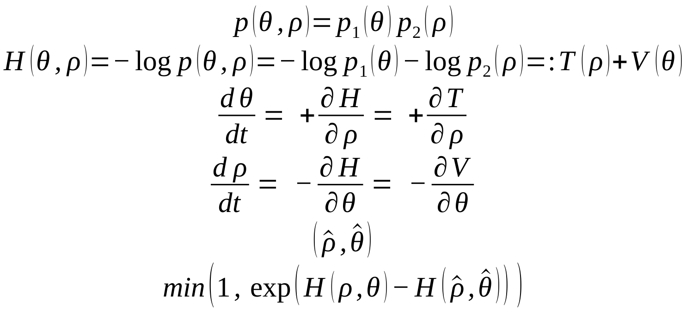
METHODS: Hamiltonian MC
parameters to infer
Idea: Simulate hamiltonian dynamics with coordinates
auxiliary "momentum"
random variable
Define the joint probability
posterior
Gaussian
centered
at 0
and an "energy":

Slide 35
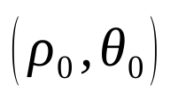
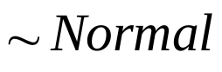
METHODS: Hamiltonian MC
Sample a new momentum

Slide 36
METHODS: Hamiltonian MC
Sample a new momentum
Integrate numerically to get the proposed samples

Slide 37
METHODS: Hamiltonian MC
Sample a new momentum
Integrate numerically to get the proposed samples
Accept or reject with Metropolis probability

Slide 38
METHODS: Hamiltonian MC
Sample a new momentum
Integrate numerically to get the proposed samples
Accept or reject with Metropolis probability
Iterate the steps to build the chain

Slide 39
METHODS: Gibbs Sampling
Idea: Sampling from a conditional probability rather than from the total posterior

Slide 40
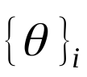
METHODS: Gibbs Sampling
Idea: Sampling from a conditional probability rather than from the total posterior
Vector of parameters
is divided in subvectors

Slide 41
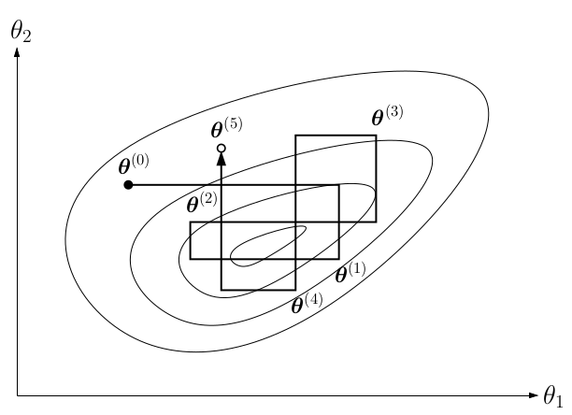
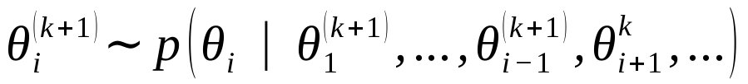
METHODS: Gibbs Sampling
Idea: Sampling from a conditional probability rather than from the total posterior
Vector of parameters
is divided in subvectors
Each subvector is sampled in turn, e.g.

Slide 42
METHODS: Gibbs Sampling
Idea: Sampling from a conditional probability rather than from the total posterior
Vector of parameters
is divided in subvectors
Each subvector is sampled in turn, e.g.
From high dimensional posterior to lower dimensional distributions

Slide 43
METHODS: Programs
STAN
Timedeppar
Implements Hamiltonian Monte Carlo
The model for the problem (data definition, parameters to infer, likelihood & priors) is specified in a "STAN code" which is compiled
Python interface
Implements Gibbs Sampling
Specific for inference of time dependent parameters in O-U processes
R interface
Once the observed data is passed, sampling starts

Slide 44
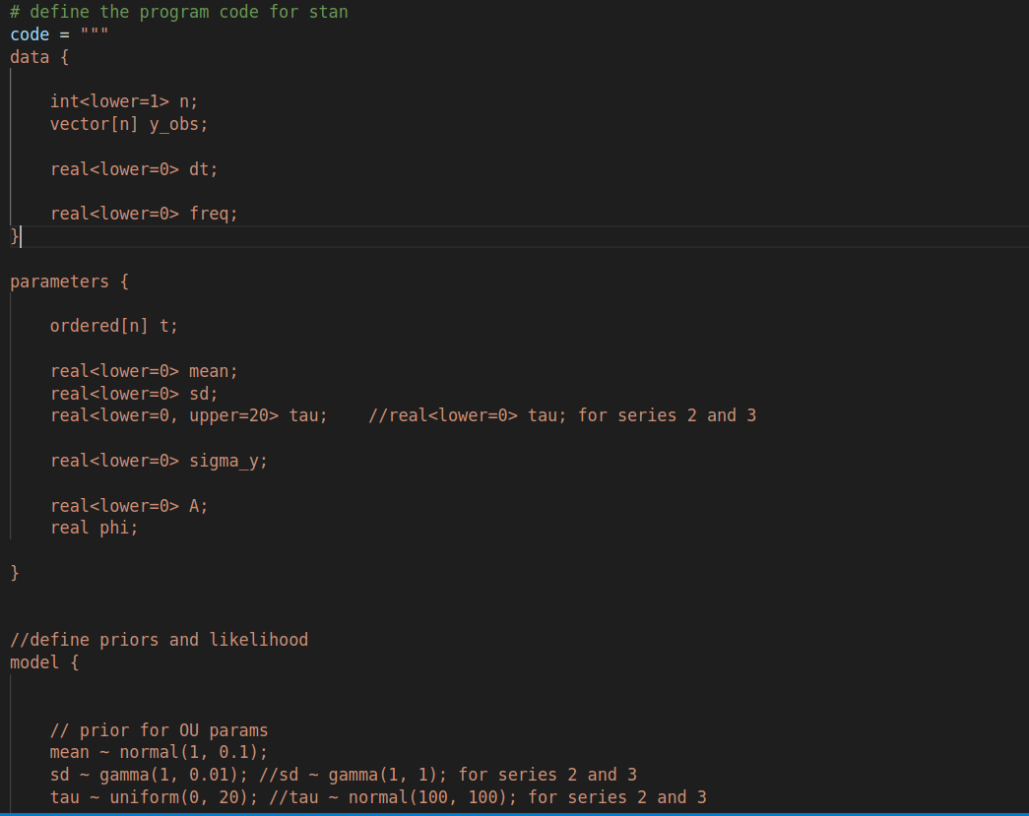
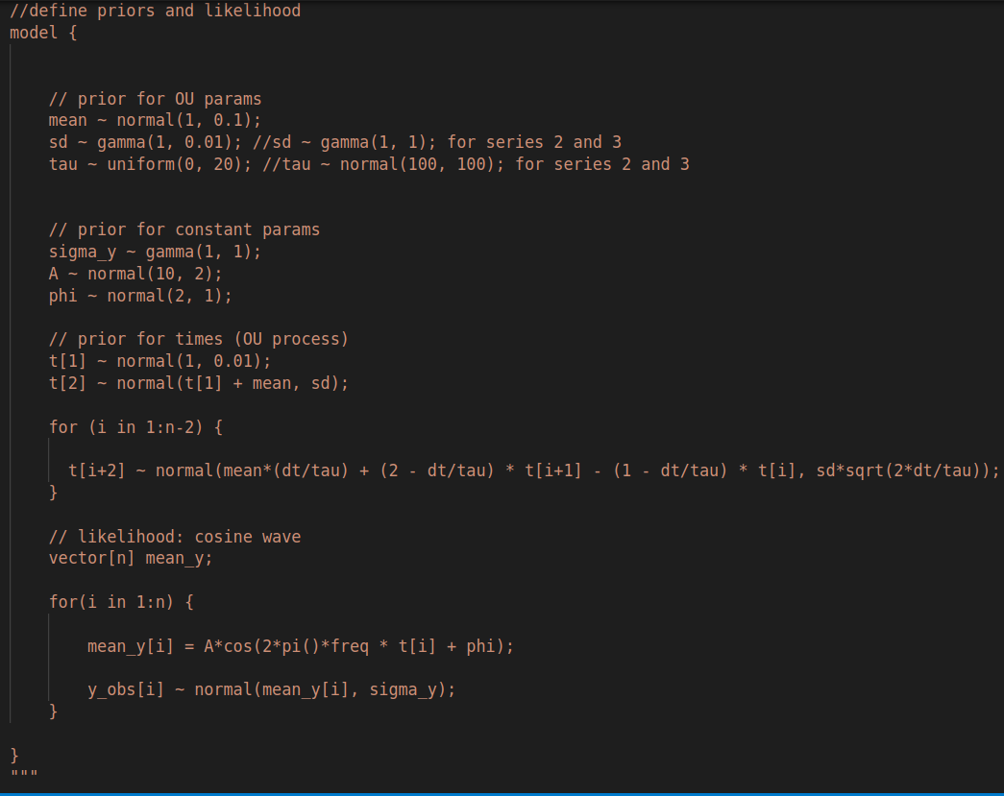
METHODS: Workflow
data
4 modules:
Model definition
'Main' to perform inference and save the chains
'Variables' to import the data of the initial spectrum
'Visualise' to analyse the chains
parameters
model

Slide 45
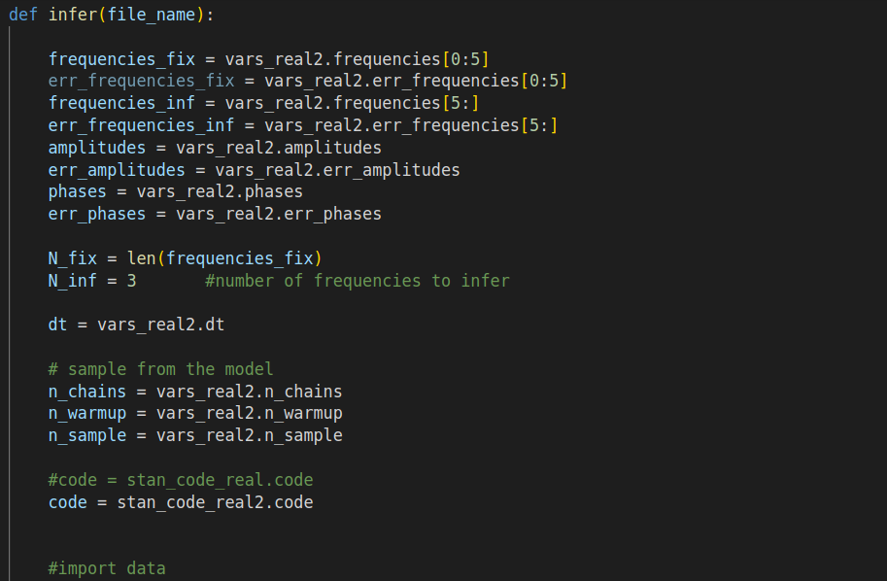
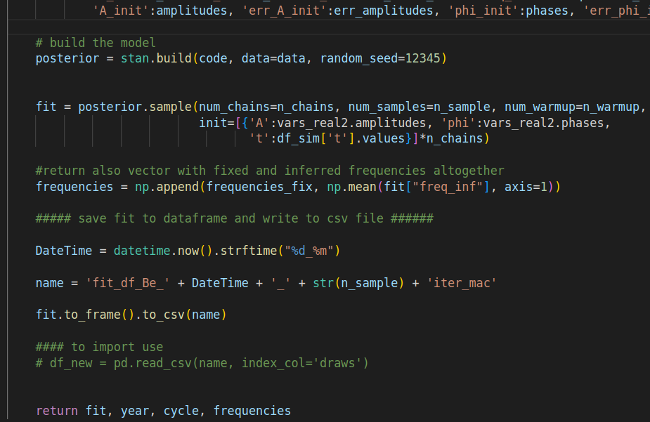
METHODS: Workflow
4 modules:
Model definition
'Main' to perform inference and save the chains
'Variables' to import the data of the initial spectrum
'Visualise' to analyse the chains
...
...

Slide 46
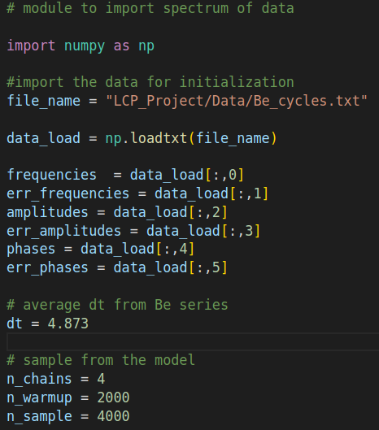
METHODS: Workflow
4 modules:
Model definition
'Main' to perform inference and save the chains
'Variables' to import the data of the initial spectrum
'Visualise' to analyse the chains

Slide 47
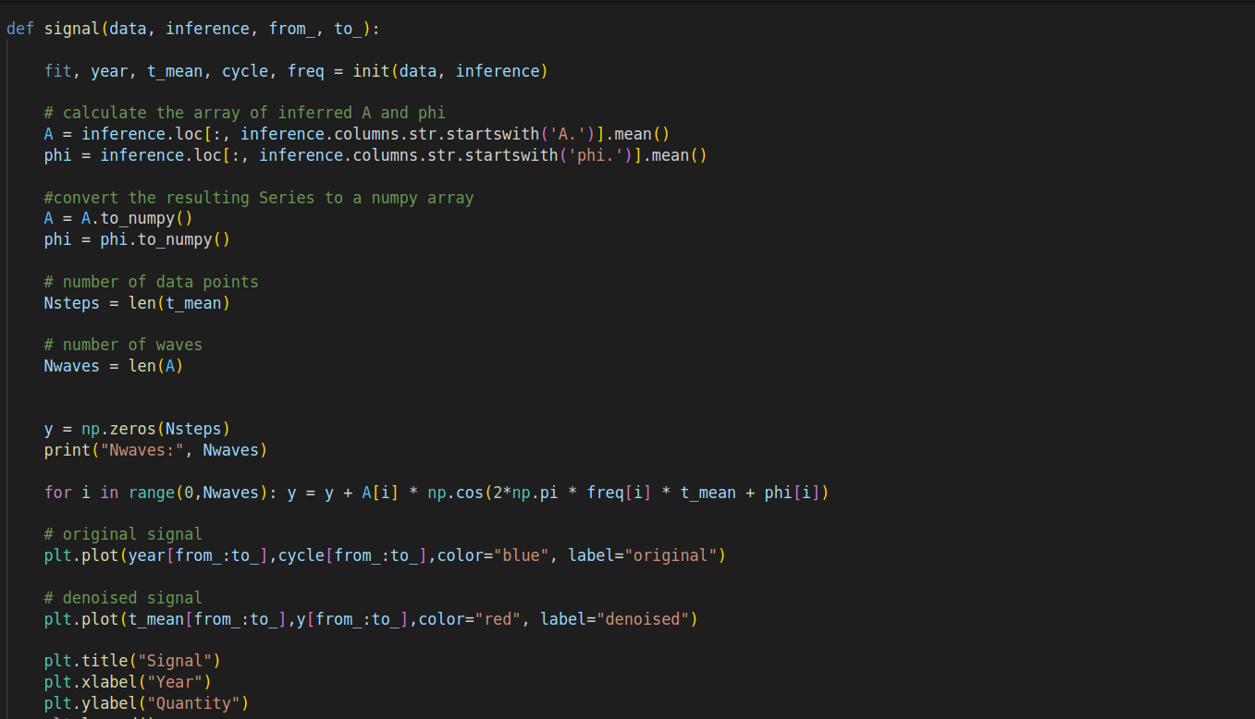
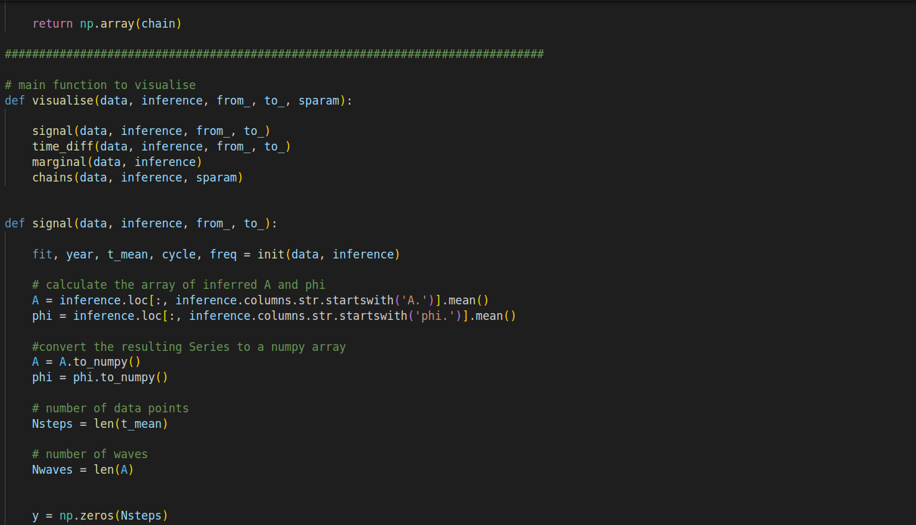
METHODS: Workflow
4 modules:
Model definition
'Main' to perform inference and save the chains
'Variables' to import the data of the initial spectrum
'Visualise' to analyse the chains
...

Slide 48
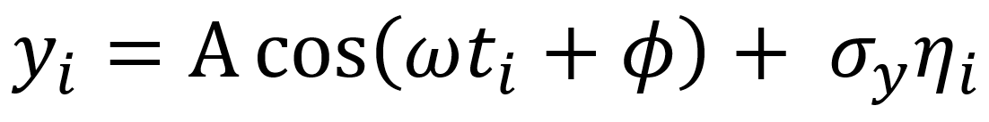
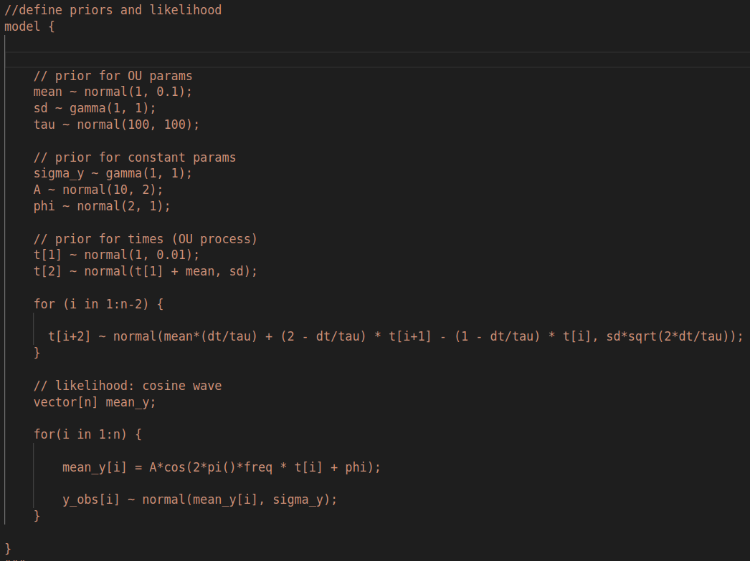
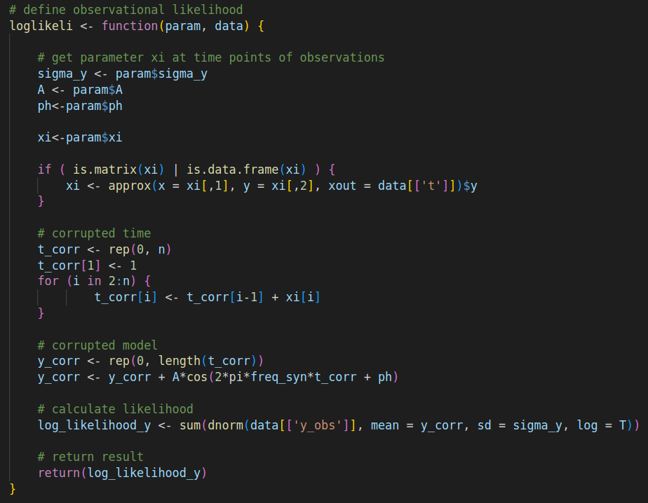
METHODS: Likelihood for Synthetic Data
STAN
TIMEDEPPAR
...
...

Slide 49
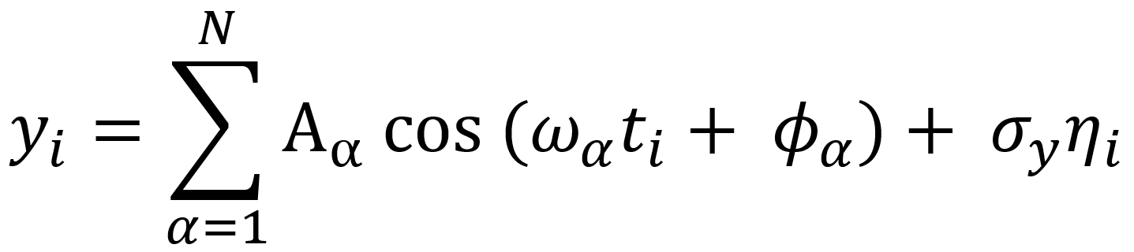
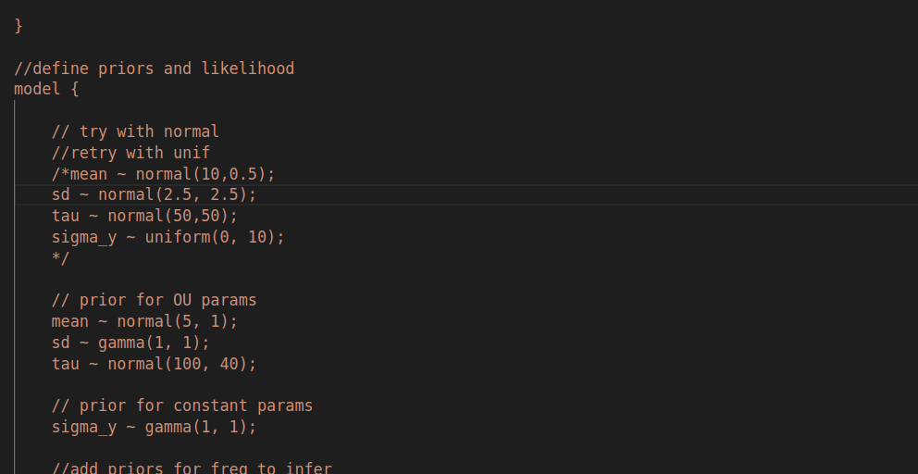
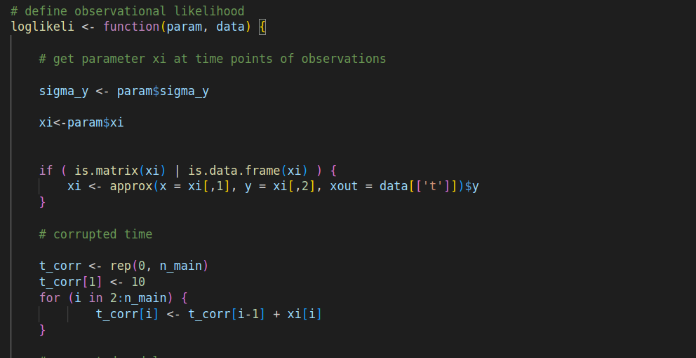
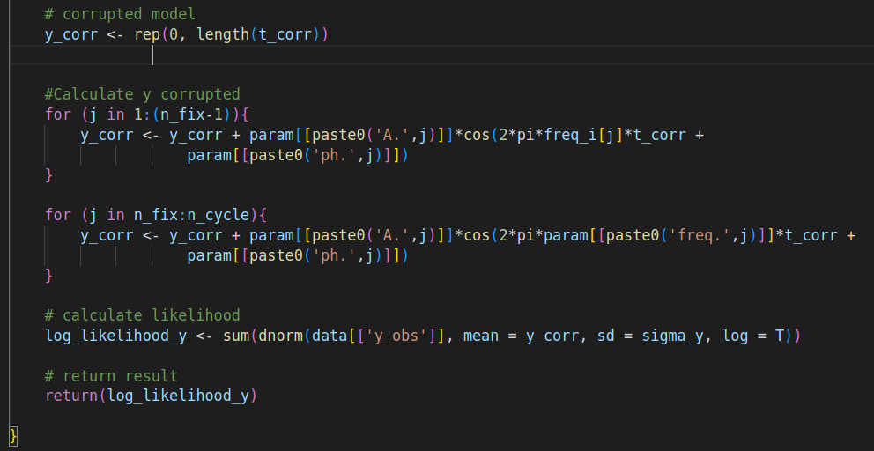
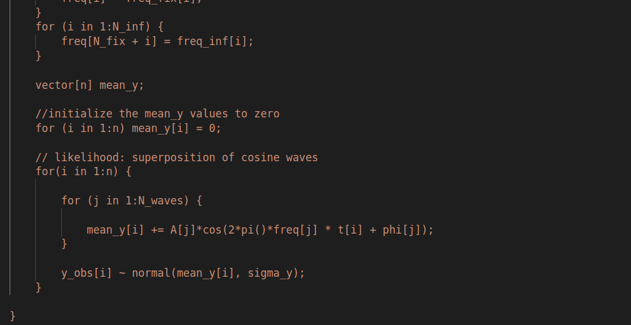
METHODS: Likelihood for Real Data
STAN
TIMEDEPPAR
...
...

Slide 50
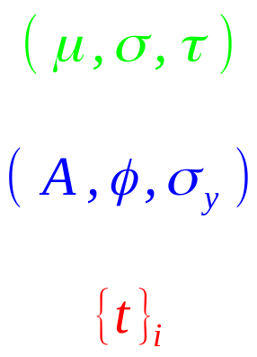
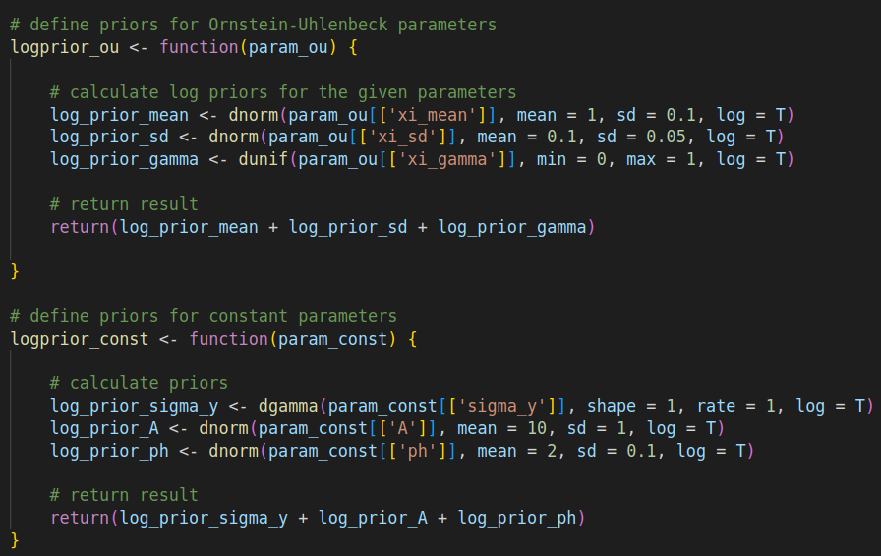
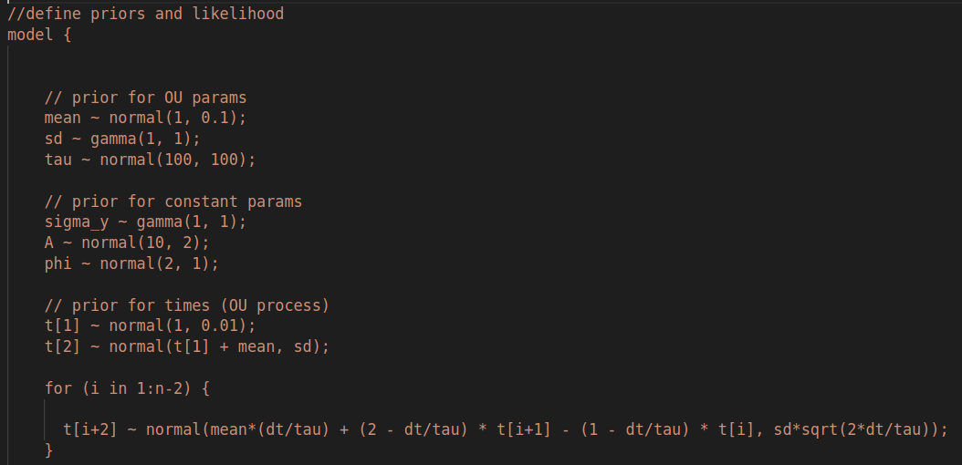
METHODS: Priors for Synthetic Data
O-U
STAN
TIMEDEPPAR
NB: For the 1st series, the prior for
Is a bit tightened

Slide 51
METHODS: Priors for Synthetic Data
Wave + noise
STAN
TIMEDEPPAR
NB: For the 1st series, the prior for
Is a bit tightened

Slide 52
METHODS: Priors for Synthetic Data
STAN
TIMEDEPPAR
timepoints
The first time is defined as peaked around the first appearing in the dataset

Slide 53
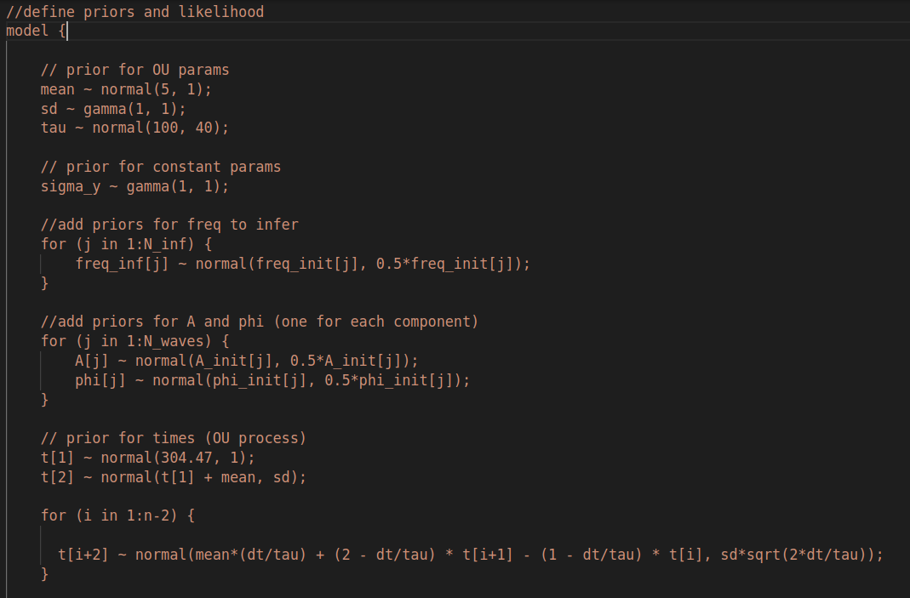
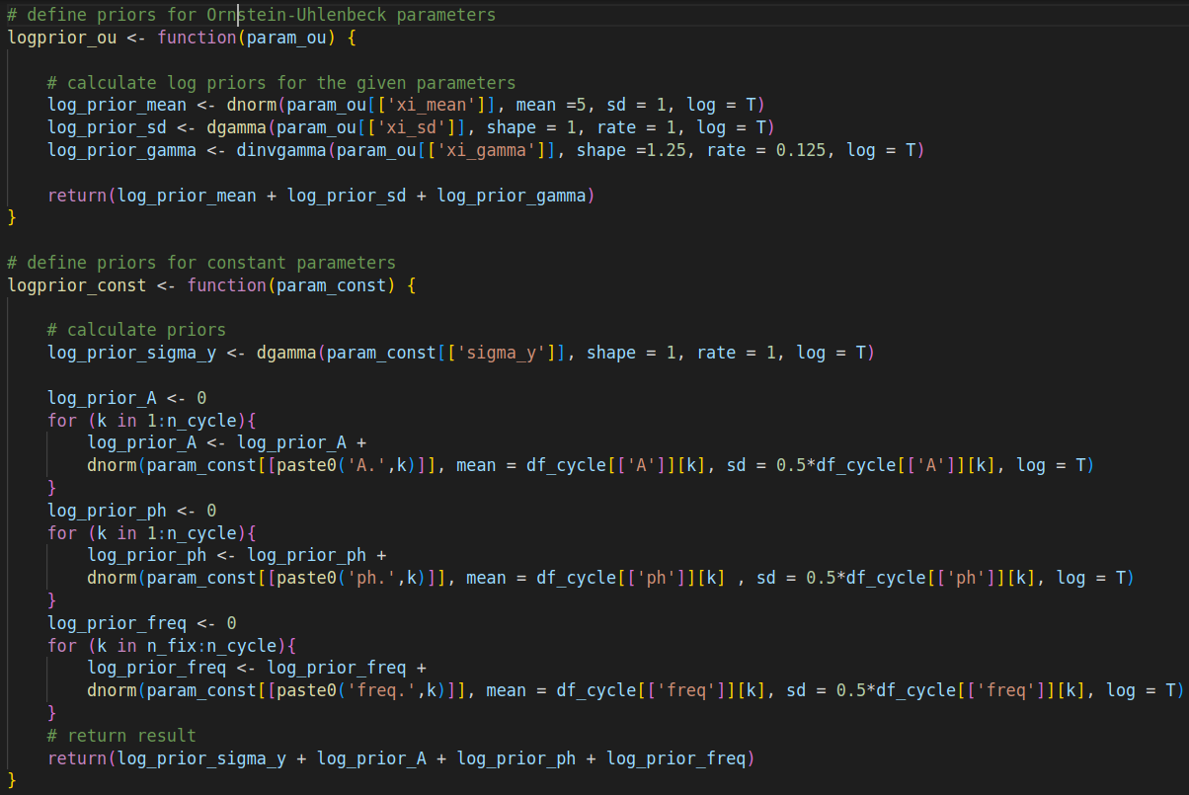
METHODS: Priors for Real Data
O-U
STAN
TIMEDEPPAR

Slide 54
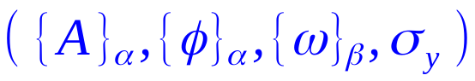
METHODS: Priors for Real Data
Waves + noise
STAN
TIMEDEPPAR

Slide 55
METHODS: Priors for Real Data
STAN
TIMEDEPPAR
timepoints

Slide 56
RESULTS AND DISCUSSION

Slide 57
RESULTS: synthetic timeseries
In order to check the performances of our methods we have performed the Bayesian inference considering three synthetic timeseries.
Each timeserie was corrupted by a not known a-priori signal
Each timeserie consisted of a single cycle with equidistant temporal sequences
The period was fixed at 11 ys

Slide 58
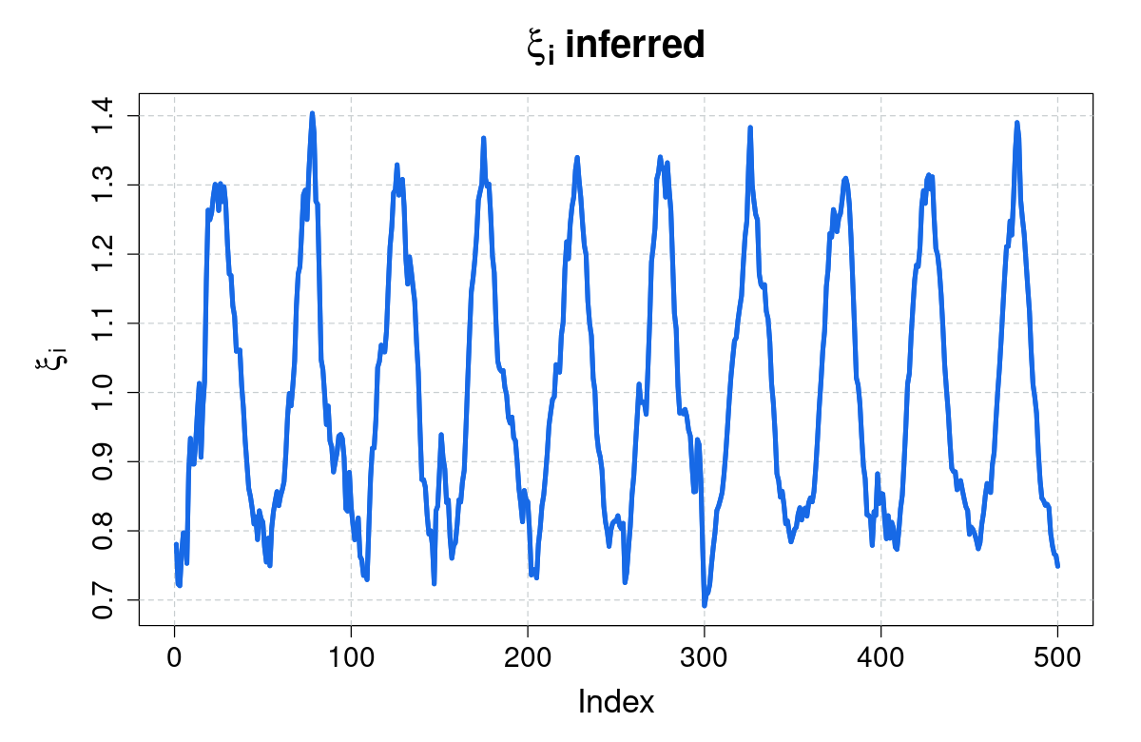
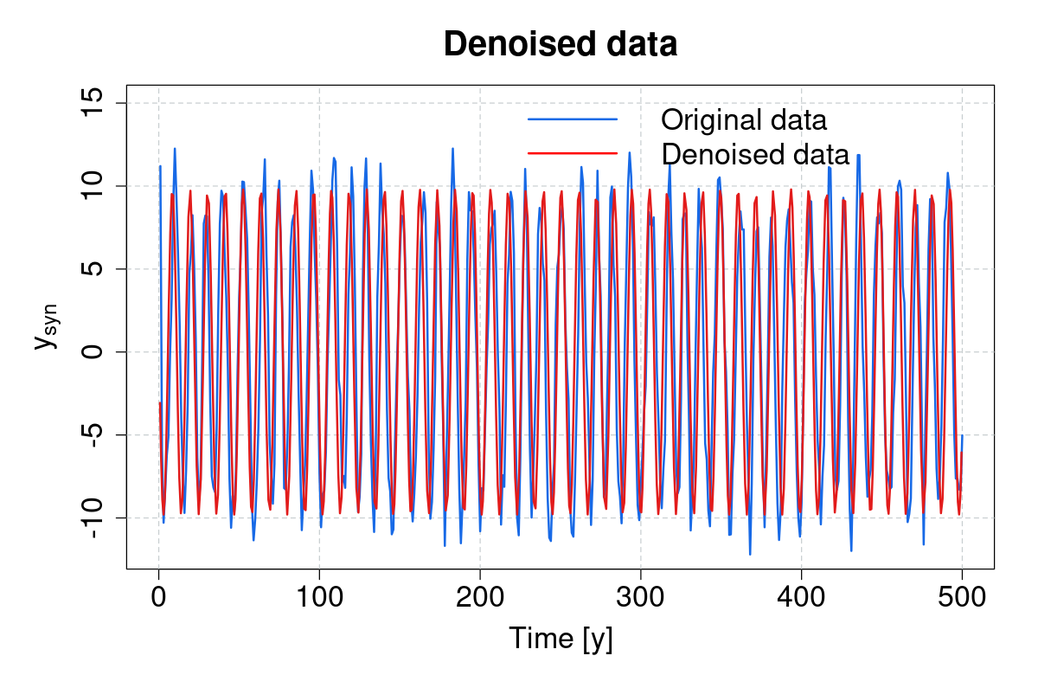
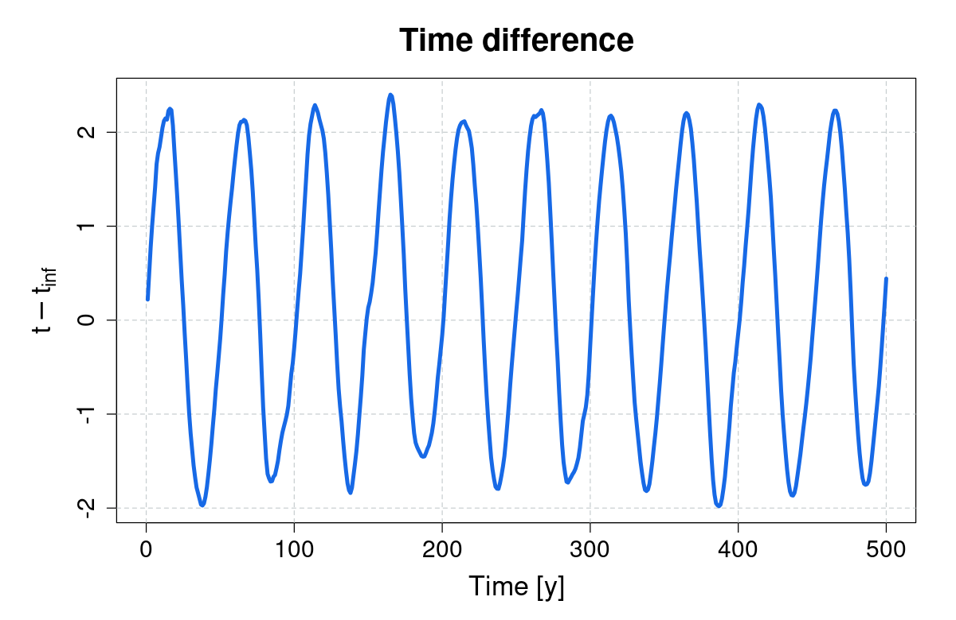
RESULTS: synthetic timeseries 1-TD
Sinusoidal signal corruption
Clear difference between original and denoised data

Slide 59
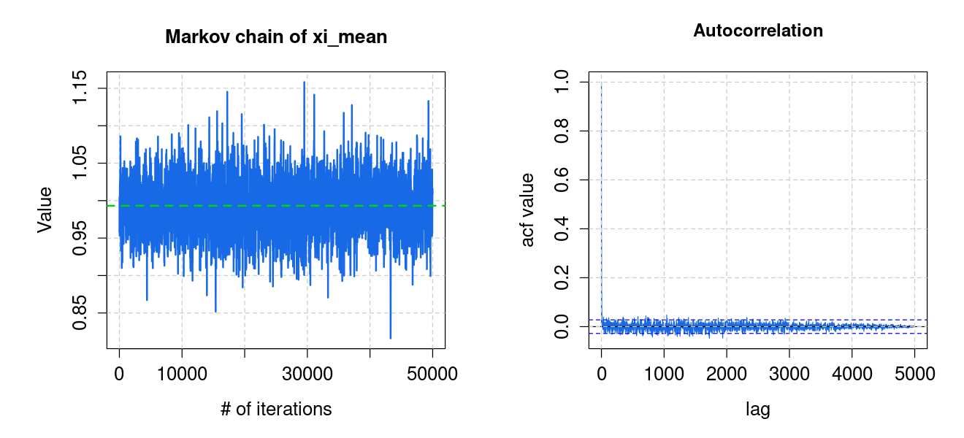
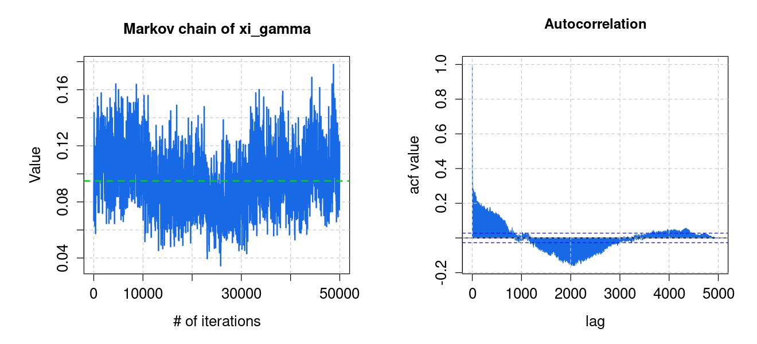
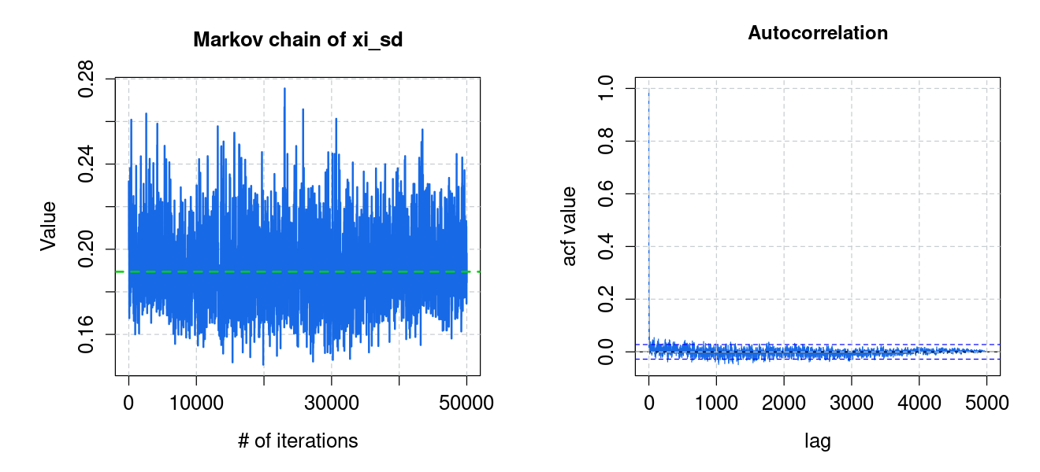
RESULTS: synthetic timeseries 1-TD
Chains are our way to check the inference's goodness
_{Chains for 𝜉mean} _{, γ and σ for OU process}

Slide 60
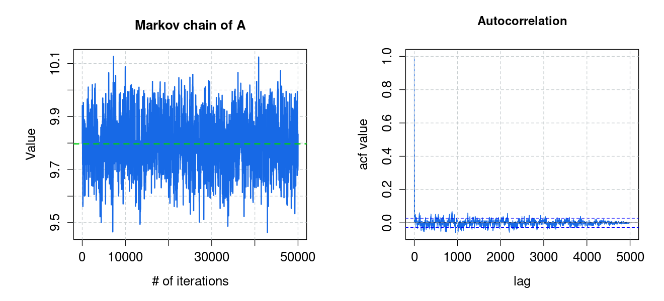
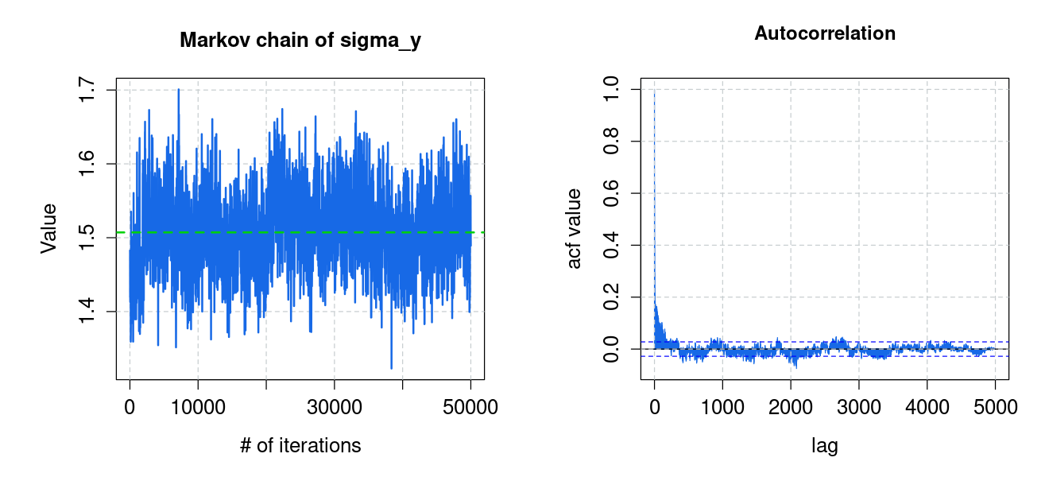
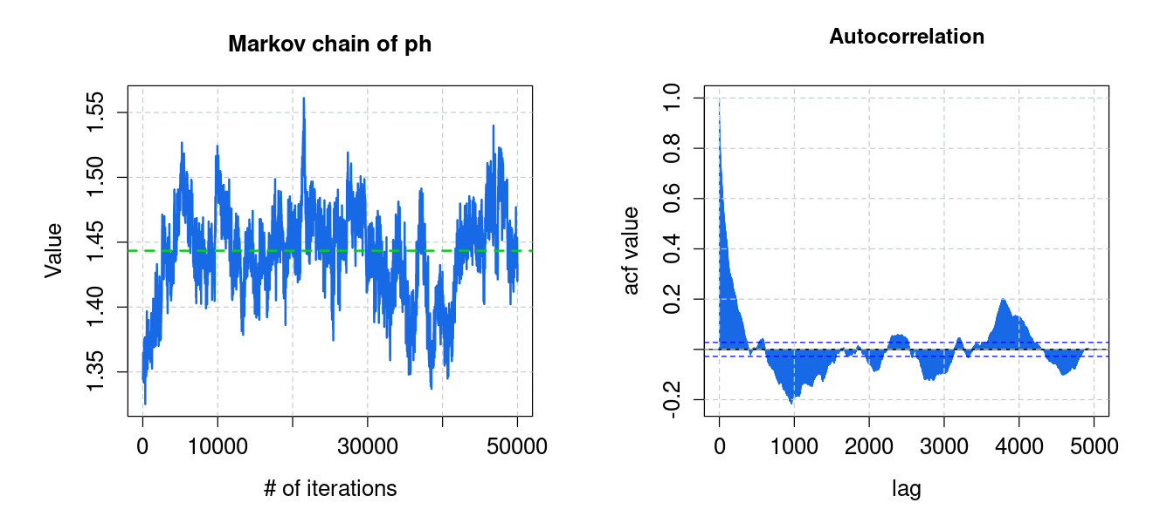
RESULTS: synthetic timeseries 1-TD
Chains for A, ,

Slide 61
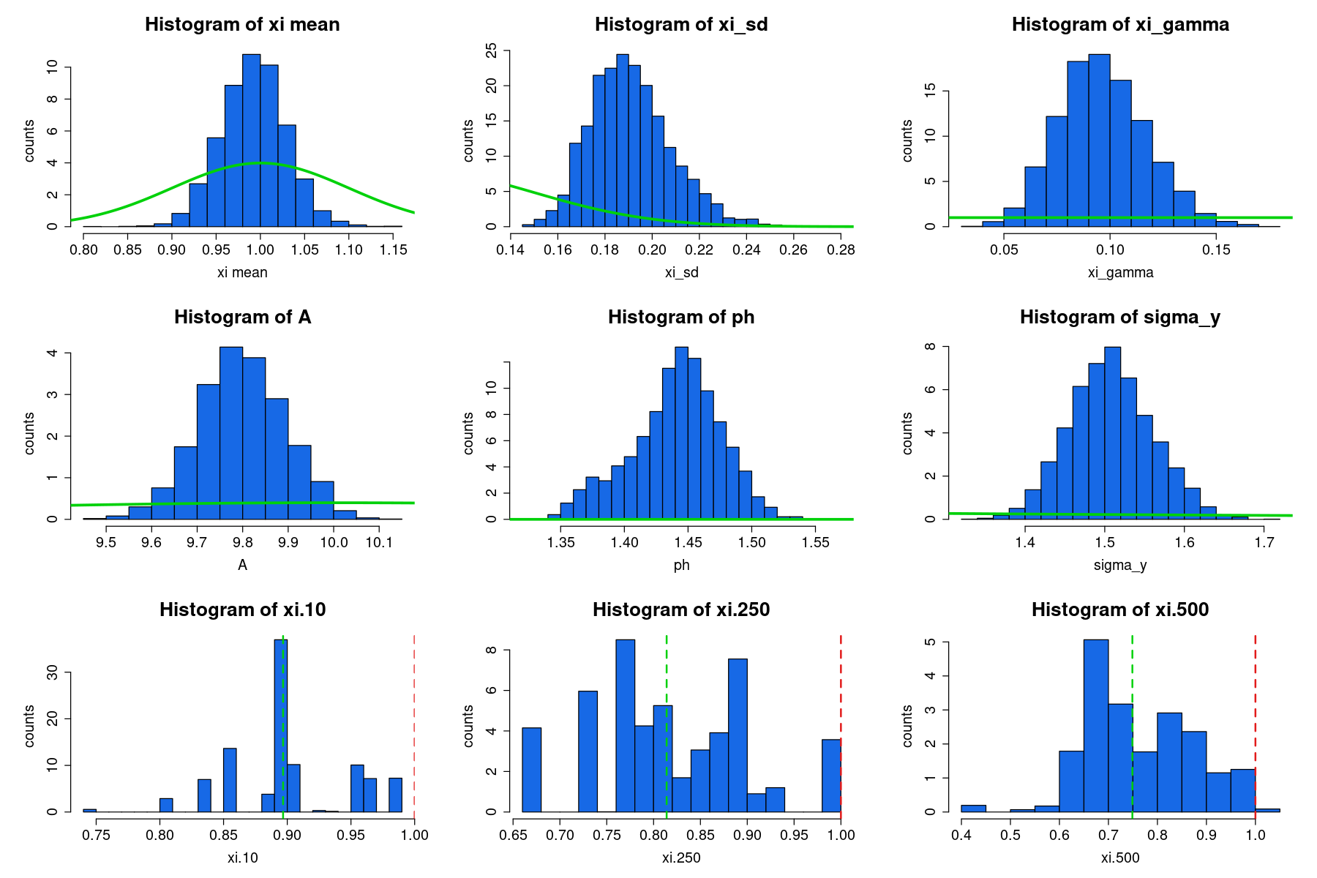
RESULTS: synthetic timeseries 1-TD
Posterior
Prior
N(1,0.1)
Γ(1,1)
U(0,1)
N(10,1)
N(2,0.1)
Γ(1,1)
Histograms of posteriors for the different parameters with the prior distributions

Slide 62
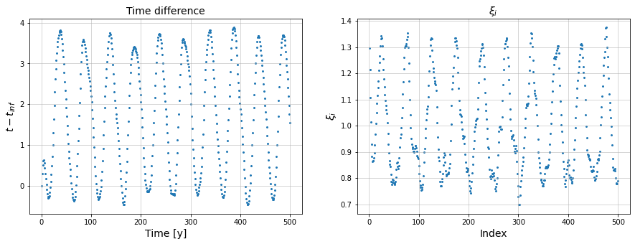
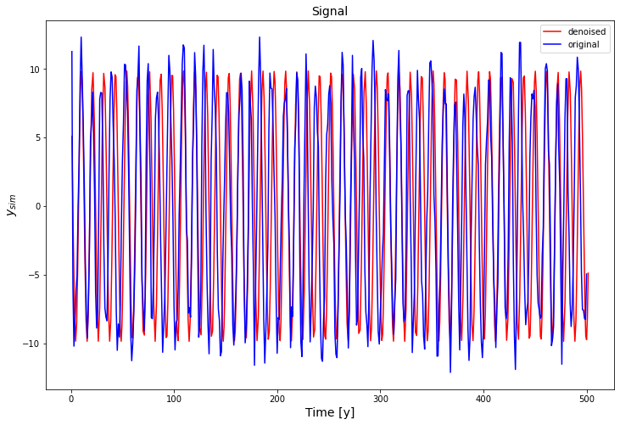
RESULTS: synthetic timeseries 1-STAN
Sinusoidal signal corruption
Clear difference between original and denoised data

Slide 63
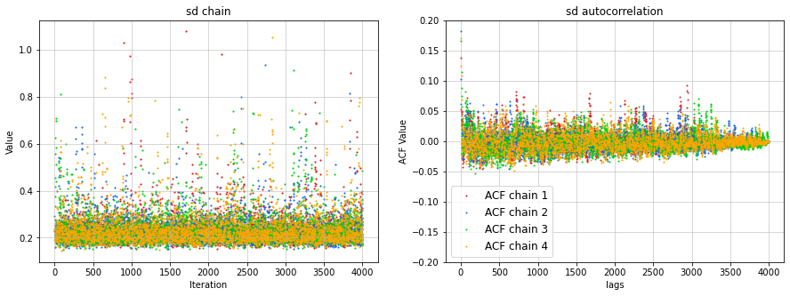

RESULTS: synthetic timeseries 1-STAN
Chains are our way to check the inference's goodness
_{Chains for 𝜉mean} _{, γ and σ for OU process}

Slide 64



RESULTS: synthetic timeseries 1-STAN
Chains for A, ,

Slide 65

RESULTS: synthetic timeseries 1-STAN
Posterior
Prior
N(1,0.1)
Γ(1,1)
N(100,100)
N(10,2)
N(2,1)
Γ(1,1)
Histograms of posteriors for the different parameters with the prior distributions

Slide 66



RESULTS: synthetic timeseries 2-TD
Random signal corruption
Almost total overlapping between original and denoised data due to the fact that the noise affecting the y is very small and the random noise ( which emerged to be superimposed to the timesteps ) has also a very small amplitude (O(10⁻⁴))

Slide 67

RESULTS: synthetic timeseries 2-TD
U(0,20)
Posterior
Prior
N(1,0.1)
Γ(1,100)
N(10,1)
N(2,0.1)
Γ(1,1)
Histograms of posteriors for the different parameters with the prior distributions

Slide 68


RESULTS: synthetic timeseries 2-STAN
Random signal corruption
data due to the fact that the noise affecting the y is very small and the random noise ( which emerged to be superimposed to the timesteps ) has also a very small amplitude (O(10⁻⁴))

Slide 69

RESULTS: synthetic timeseries 2-STAN
Posterior
Prior
U(0,200)
N(1,0.1)
Γ(1,0.01)
N(10,1)
N(2,0.1)
Γ(1,1)
Histograms of posteriors for the different parameters with the prior distributions

Slide 70



RESULTS: synthetic timeseries 3-TD
Step function corruption with 2 steps which reflects into a rump for time difference
Total overlapping between original and denoised data due to very small noise except for the "ramp region"

Slide 71

RESULTS: synthetic timeseries 3-TD
Posterior
Prior
N(1,0.1)
Γ(1,1)
U(0,1)
N(10,1)
Γ(1,1)
N(2,0.1)
Histograms of posteriors for the different parameters with the prior distributions

Slide 72


RESULTS: synthetic timeseries 3-STAN
Step function corruption but we have a double jump.
2 cycles are skipped between 200 and 400 ys

Slide 73

RESULTS: synthetic timeseries 3-STAN
Posterior
Prior
N(1,0.1)
Γ(1,1)
N(100,100)
N(2,1)
Γ(1,1)
N(10,1)
Histograms of posteriors for the different parameters with the prior distributions

Slide 74

RESULTS: Be 10 timeseries
Bayesian inference was performed considering the following reference C-14 periods:
Fixed C-14
periods
Signal's periods [y] | Δ (%)
8872.50 | -
2185.80 | -
972.53 963.49 | 0.93
349.91 349.12 | 0.23
230.23 234.00 | 1.64
207.16 207.96 | 0.39
87.43 87.85 | 0.48
86.10 | -

Slide 75



RESULTS: Be 10 timeseries
Hard to compare due to different number of inferred cycles

Slide 76


RESULTS: Be 10 timeseries

Slide 77



RESULTS: Be 10 timeseries
Chains for A, of 6th cycle and
Similar chains for other cycles parameters

Slide 78



RESULTS: Be 10 timeseries
Chains for 𝜉_{mean} , γ and σ for OU process
Wider oscillations w.r.t. constant parameters

Slide 79


RESULTS: Be 10 timeseries
Inferred frequencies:
Largest period and amplitude
Inferred frequency
Corrected frequency
Original frequency

Slide 80

RESULTS: Be 10 timeseries
Posterior
Prior
Mean value
Original value

Slide 81
RESULTS: Be 10 timeseries
Comparison between inferred periods and correspondent periods from previous correction:
Initial periods [y] | Inferred periods [y] | Corrected periods [y] | Δ (%)
8872.50 | 9007.15 | 9015.10 | 0.09
2185.80 | 2196.98 | 2219.30 | 1.02
972.53 963.49 | - | 978.74 | 1.58
349.91 349.12 | - | 353.06 | 1.13
230.23 234.00 | - | 233.95 | 0.02
207.16 207.96 | - | 208.95 | 0.48
87.43 87.85 | - | 87.83 | 0.02
86.10 | 89.47 | - | -
Fixed C-14
periods

Slide 82

RESULTS: Be 10 timeseries
Comparison between inferred periods and correspondent periods from previous correction:

Slide 83
CONCLUSIONS

Slide 84
CONCLUSIONS
Time-scale correction on isotopes' timeseries from ice cores

Slide 85
CONCLUSIONS
Time-scale correction on isotopes' timeseries from ice cores
Signal's model: sum of waves + noise Timestamps' model: Ornstein-Uhlenbeck

Slide 86
CONCLUSIONS
Time-scale correction on isotopes' timeseries from ice cores
Signal's model: sum of waves + noise Timestamps' model: Ornstein-Uhlenbeck
Bayesian inference to calculate posterior probabilities for the parameters, by means of MC sampling

Slide 87
CONCLUSIONS
Time-scale correction on isotopes' timeseries from ice cores
Signal's model: sum of waves + noise Timestamps' model: Ornstein-Uhlenbeck
Bayesian inference to calculate posterior probabilities for the parameters, by means of MC sampling
Synthetic datasets to test the program

Slide 88
CONCLUSIONS
Time-scale correction on isotopes' timeseries from ice cores
Signal's model: sum of waves + noise Timestamps' model: Ornstein-Uhlenbeck
Bayesian inference to calculate posterior probabilities for the parameters, by means of MC sampling
Synthetic datasets to test the program
Be-10 timeseries: PS compared to C-14

Slide 89
CONCLUSIONS
Time-scale correction on isotopes' timeseries from ice cores
Signal's model: sum of waves + noise Timestamps' model: Ornstein-Uhlenbeck
Bayesian inference to calculate posterior probabilities for the parameters, by means of MC sampling
Synthetic datasets to test the program
Be-10 timeseries: PS compared to C-14
Comparison to corrected Be-10 timeseries:
Inferred periods move closer to the corrected ones

Slide 90
CONCLUSIONS
Time-scale correction on isotopes' timeseries from ice cores
Signal's model: sum of waves + noise Timestamps' model: Ornstein-Uhlenbeck
Bayesian inference to calculate posterior probabilities for the parameters, by means of MC sampling
Synthetic datasets to test the program
Be-10 timeseries: PS compared to C-14
Comparison to corrected Be-10 timeseries:
Inferred periods move closer to the corrected ones
Periods fixed from C-14 cycles: 2 further from corrected ones, 3 closer

Slide 91
CONCLUSIONS
Time-scale correction on isotopes' timeseries from ice cores
Signal's model: sum of waves + noise Timestamps' model: Ornstein-Uhlenbeck
Bayesian inference to calculate posterior probabilities for the parameters, by means of MC sampling
Synthetic datasets to test the program
Be-10 timeseries: PS compared to C-14
Comparison to corrected Be-10 timeseries:
Inferred periods move closer to the corrected ones
Periods fixed from C-14 cycles: 2 further from corrected ones, 3 closer
Good agreement between the considered cycles and the corrected ones

Slide 92
THANK YOU

